Slide 1
Making API Requests using cURL and Postman

Slide 2
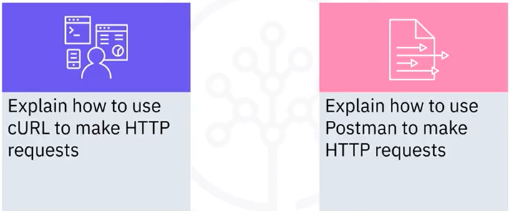
What you will learn

Slide 3

cURL
• curl (short for "Client URL")
• Command line tool and library for transferring
data with URLs
• Used in command lines or scripts to transfer
data
• Use cases:
• Downloading files from the internet
• Endpoint testing
• Debugging
• Error logging
• Protocols
• HTTP, HTTPS, FTP and IMAP
curl://
$ curl https://www.example.com/

Slide 4
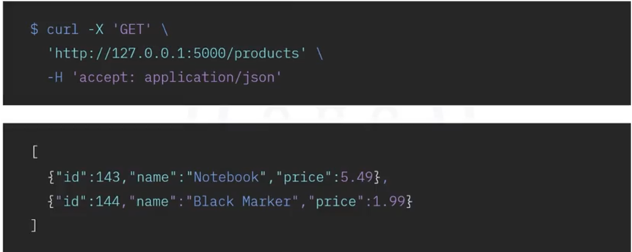
Products microservice with cURL

Slide 5

Postman
• An API platform for building and
using APIs
• Simplifies each step of API
lifecycle
• Streamlines collaboration to
create better APIs more quickly
• A popular choice for testing
APIs
• Example: WhatsApp Business
Platform Cloud API
POSTMAN

Slide 6
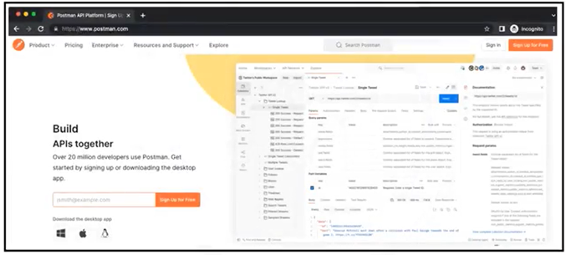
How to use Postman
• Download or online

Slide 7
Recap
• cURL is used for transferring data with URLs
• CURL can be used at a command line or in scripts
• Postman is an API platform for building and using APIs
• Postman is a simple and popular tool for testing APIs

